Slide 1

Federated Fair Recommendation with LLM-Based User Profiling
School of Computer Science And Engineering
P Manas (23BCE5076)
Vivaash Koundal (23BCE5095)
Varhade Advait Ravindrakumar (23BCE5098)
Guide Name:
Suganeshwari

Slide 2
Contents
Field of Work & Objectives
Introduction
Literature survey
Conclusions from the Literature Survey
Problem Definition (Objective & Scope)
Methodology/Work Plan (Chart)
Design standards & Realistic Constraints
Work done
Work to be done
Time line
References

Slide 3
Field of Work and
Objectives
Field of Work:
Privacy-Preserving Recommender Systems, Federated Learning and Fairness.
Objectives:
1. Adapt the SUPER framework to a federated setting (FedSUPER) to protect user data.
2. Integrate LLM-based user profiling to recover accuracy drops caused by federated sparsity.
3. Ensure original SUPER calibration guarantees (Rmse-PC) are strictly maintained.

Slide 4
Introduction
Recommender systems often suffer from popularity bias, overshadowing long-tail items. The SUPER framework effectively mitigates this by merging head and tail recommendations via user-specific blueprints. However, SUPER is centralized, creating privacy risks. Federated Learning solves privacy but degrades recommendation accuracy. This project integrates LLM semantic user profiles into FedSUPER to achieve both privacy and high accuracy.

Slide 5
Literature Survey
S. No. | Paper Title | Venue | Year | Important Findings
1 | BGTplanner: Maximizing Training Accuracy for Differentially Private Federated Recommenders via Strategic Privacy Budget Allocation | arXiv | 2024 | To mitigate the rising concern about privacy leaka...
2 | Centering Policy and Practice: Research Gaps around Usable Differential Privacy | arXiv | 2024 | As a mathematically rigorous framework that has am...
3 | Decentralized Matrix Factorization with Heterogeneous Differential Privacy | arXiv | 2022 | Conventional matrix factorization relies on centra...
4 | Differential Private Knowledge Transfer for Privacy-Preserving Cross-Domain Recommendation | arXiv | 2022 | Cross Domain Recommendation (CDR) has been popular...
5 | Meta-Learning and Targeted Differential Privacy to Improve the Accuracy-Privacy Trade-off in Recommendations | arXiv | 2026 | Balancing differential privacy (DP) with recommend...

Slide 6
Literature Survey (Cont.)
Literature Survey
S. No. | Paper Title | Venue | Year | Important Findings
6 | Position Paper on Simulating Privacy Dynamics in Recommender Systems | arXiv | 2021 | In this position paper, we discuss the merits of s...
7 | Randomized algorithms for precise measurement of differentially-private, personalized recommendations | arXiv | 2023 | Personalized recommendations form an important par...
8 | Successive Point-of-Interest Recommendation with Local Differential Privacy | arXiv | 2019 | A point-of-interest (POI) recommendation system pe...
9 | The Impact of Differential Privacy on Recommendation Accuracy and Popularity Bias | arXiv | 2024 | Collaborative filtering-based recommender systems ...
10 | Towards Differential Privacy in Sequential Recommendation: A Noisy Graph Neural Network Approach | arXiv | 2023 | With increasing frequency of high-profile privacy ...

Slide 7
Literature Survey (Cont.)
Literature Survey
S. No. | Paper Title | Venue | Year | Important Findings
11 | A Survey on Federated Recommendation Systems | arXiv | 2022 | Federated learning has recently been applied to re...
12 | A Systematic Survey on Federated Sequential Recommendation | arXiv | 2025 | Sequential recommendation is an advanced recommend...
13 | Blockchain-based Federated Recommendation with Incentive Mechanism | arXiv | 2024 | Nowadays, federated recommendation technology is r...
14 | Dual Personalization on Federated Recommendation | arXiv | 2023 | Federated recommendation is a new Internet service...
15 | Federated Continual Recommendation | arXiv | 2025 | The increasing emphasis on privacy in recommendati...

Slide 8
Outcome of
Literature Survey
Research Gaps Identified:
No existing work provides a mathematically guaranteed popularity calibration (like SUPER) in a fully federated, privacy-preserving manner.
Traditional federated learning causes severe accuracy drops on long-tail items due to client-side data sparsity.
LLM semantic integration has not been explored as a mechanism to rescue accuracy specifically within the constraints of strict popularity-calibration blueprints.

Slide 9
Problem Definition
Objectives:
Implement a Federated SUPER (FedSUPER) baseline.
Integrate LLM profile semantics (Sentence-BERT) into the federated pipeline.
Evaluate models on the ML-1M dataset.
Scope of the Study:
Focuses on the MovieLens-1M dataset to evaluate implicit feedback recommendations.
Primary evaluation metrics: Recall@20 (for accuracy) and Rmse-PC (to validate calibration preservation).

Slide 10
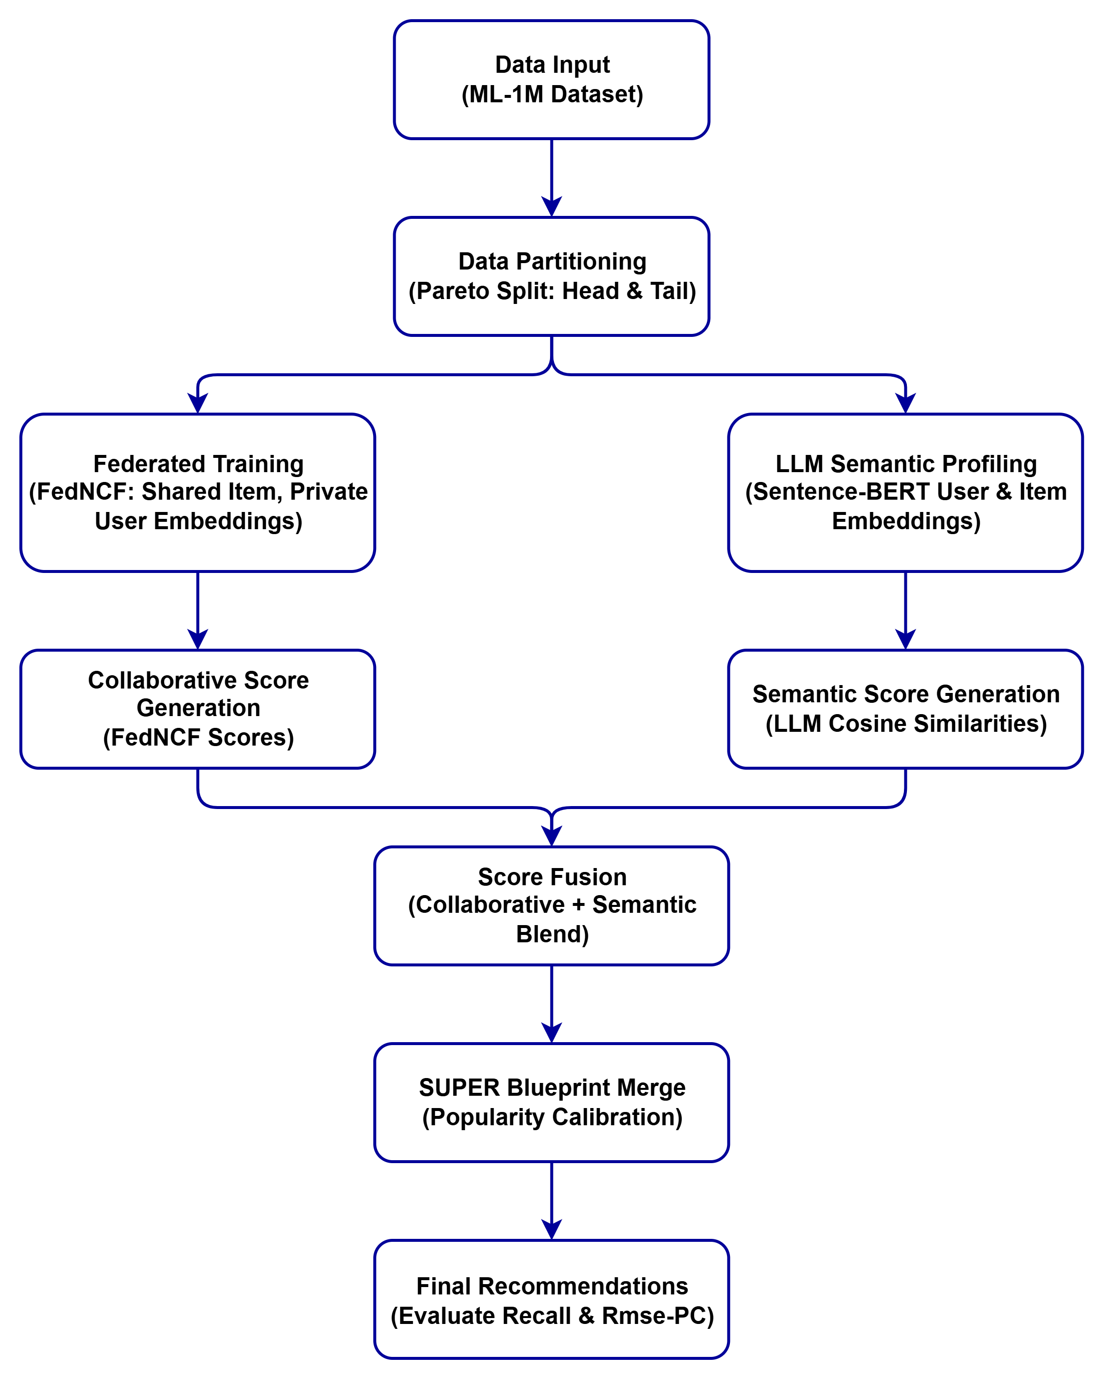
Methodology

Slide 11
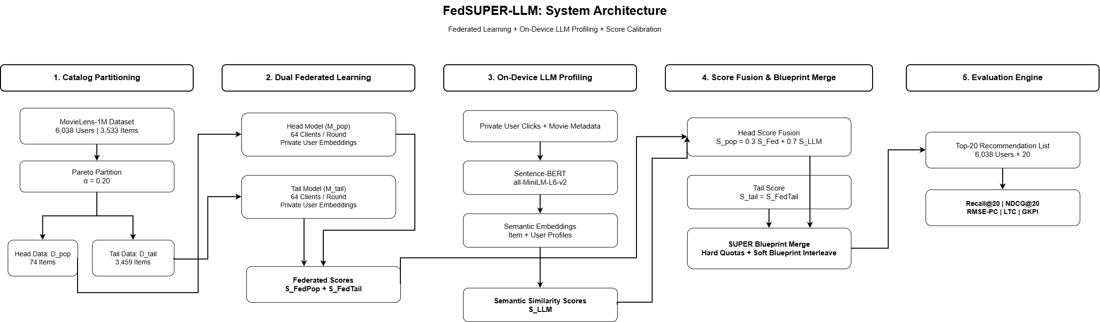
Architecture

Slide 12
Realistic Constraints
Experimental Design & Implementation:
Baseline data pipeline completed for ML-1M dataset partitioning.
Federated Collaborative Filtering (FedNCF) core architecture setup.
LLM Sentence-BERT integrated for initial semantic profiling.
SUPER blueprint merging algorithm implemented in federated clients.
The experimental environment is fully configured and ready for executing large-scale evaluations.

Slide 13
Project Demonstration
Execute full experimental evaluation to measure Recall@20 and Rmse-PC.
Finalize the comparison showing LLM-FedSUPER recovering the recall gap while maintaining calibration.
Document the privacy-utility trade-offs thoroughly.
Prepare the final report detailing the empirical findings.

Slide 14
Work to be done
Work to be done:
Formal documentation of the privacy-utility trade-offs and composite FDN-A metrics.
Finalizing the project report and drafting the research paper.
Code cleanup, documentation, and preparation for open-source publication.

Slide 15
Time Line

Slide 16
References
1. Yavru, S. et al. (2026). SUPER: Smart User-centric Popularity Exposure Reduction for Fair and Diverse Recommendations, IEEE Access.
2. Perifanis, V. et al. (2021). Federated Neural Collaborative Filtering, Knowledge-Based Systems.
3. Reimers, N. et al. (2019). Sentence-BERT: Sentence Embeddings using Siamese BERT-Networks, EMNLP.

